Slide 1




SHE++V5.0
HOME
PROBLEM
SOLUTION
OTHERS
Fake Food Review AI-Detector
Group Member:
Lee Pei Yu
Ngoh Zhiyu
Chong Ching Ying
Ng Tien Tien
Ong Kher Jing
GREAT MALAYSIA AI
HACKATHON 2025
Notes:
Slide 1: Problem Statement
“Good evening, we are from group SHE++v5.0. Today, we will be presenting our solution for detecting AI-generated food reviews.

Slide 2


SHE++V5.0
HOME
PROBLEM
SOLUTION
OTHERS
Default app for food review is Google Maps. But review like these are easily faked. This AI tool will scrape the web and consolidate food reviews, determining which are likely written by bots or seem suspiciously fake due to promotions being held by restaurants. This helps in determining which restaurants are actually worth visiting.
Track:
Problem Statement:
AI-powered review generators are increasingly used to create fake food reviews that look authentic. These fake food review mislead consumers, damage the reputation of restaurant, and reduce trust in food delivery and review platforms. Current moderation methods are not effective in detecting these AI-generated reviews, creating the need for a reliable detection system. Additionally, many restaurants attempt to artificially inflate their review counts, generating numerous irrelevant and unrelated reviews that further distort customer perception and undermine fairness in the marketplace
The lack of effective mechanisms to filter out fake reviews lead to:
Consumers making poor food choices based on manipulated ratings.
Restaurant and vendors facing unfair competition or reputational damage
Notes:
Our problem is:
AI-powered review generators are increasingly being used to create fake food reviews that look authentic. These reviews mislead consumers, damage restaurant reputations, and reduce trust in food delivery and review platforms.
Current moderation methods are not effective in detecting these AI-generated reviews, creating the need for a reliable detection system.
The Impact from this
Consumers may make poor food choices based on manipulated ratings.
Restaurants and vendors face unfair competition and potential reputational damage.
Our goal is to develop a system that accurately detects AI-generated reviews, helping maintain trust in food platforms and protect both consumers and restaurants.”
Now I will pass to my friend for the minimum viable product demonstration.

Slide 3
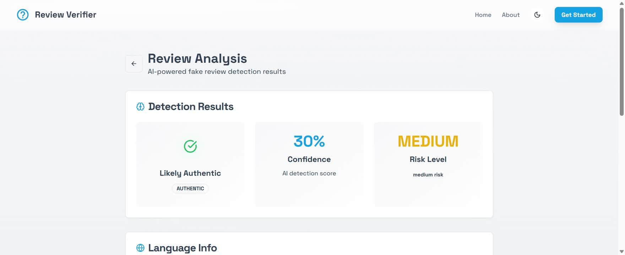


Slide 4
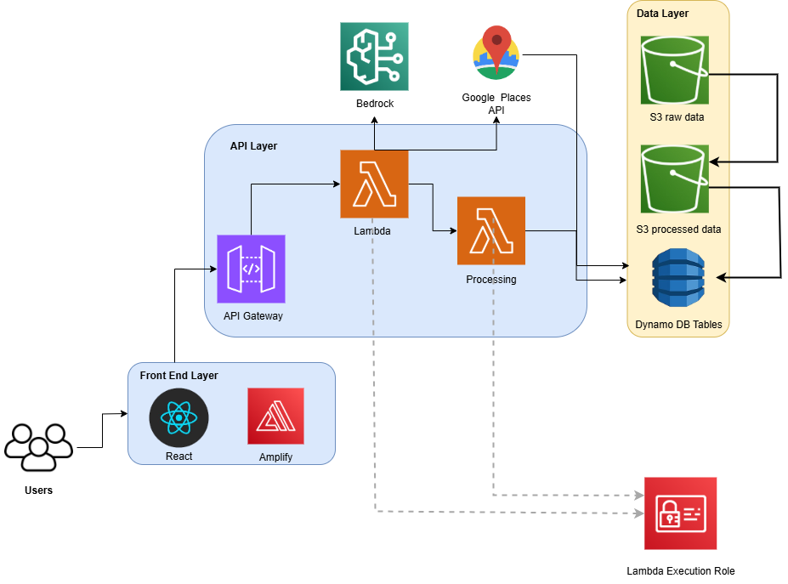

SHE++V5.0
HOME
PROBLEM
SOLUTION
OTHERS
Proposed solution
Configuration Steps:
First, develop the React frontend and deploy it using AWS Amplify to serve as the user interface for the application and setup the API Gateway.
1
Implement Lambda functions to handle API Gateway endpoints: one to retrieve restaurant reviews from the Google Places API, and another to process and analyze the data. Assign a Lambda execution role with permissions for S3, DynamoDB, Bedrock, and secure access to the Google Places API.
2
Configure the S3 buckets: one for storing raw review data fetched from Google Places, and another for storing the processed output after AI analysis. Create a DynamoDB table to store structured metadata, such as restaurant IDs, review statistics, and detection results.
3
Sample Traffic Flow:
1
A client interact with the React frontend to either paste a review text for AI detection or search for a restaurant to analyze its reviews.
2
When a review is submitted, the API Gateway routes the request to a Lambda function, which uses Bedrock to analyze the text and determine whether it is AI-generated, returning resulting results.
For restaurant analysis, the client enters a restaurant name, which the API Gateway sends to a Lambda function. The Lambda retrieves reviews from the Google Places API, stores them in S3 and DynamoDB, and uses Amazon Bedrock to detect AI-generated reviews. It then calculates percentages and returns a summary with detailed results to the frontend.
3
Notes:
We start with the users, who interact with the application through a React front end, hosted and managed with AWS Amplify. This provides a simple and responsive interface for users to access the platform.
Requests from the front end are routed through the API Gateway into our API Layer. Here, AWS Lambda functions handle the logic. One Lambda function directly calls the Google Places API to fetch restaurant data and reviews. This allows us to gather real-time review information directly from the source.
Once the raw reviews are collected, they are passed to our Processing Lambda, which applies detection logic. This step may include using Amazon Bedrock for AI-based analysis, such as identifying fake or bot-generated reviews.
On the Data Layer, raw reviews are stored in an S3 bucket for raw data, while processed reviews are saved in a separate S3 bucket for cleaned and analyzed data. Structured information, such as flagged reviews or restaurant-level summaries, is stored in DynamoDB tables for fast querying and reporting.
The entire process is secured through the Lambda Execution Role, ensuring that each Lambda has controlled access to only the services it needs—such as S3, DynamoDB, Bedrock, and the Google Places API.
In summary, this architecture enables us to fetch live restaurant reviews, process them with AI models to detect suspicious activity, and securely store both raw and processed insights, creating a scalable, serverless food review detection system."**

Slide 5
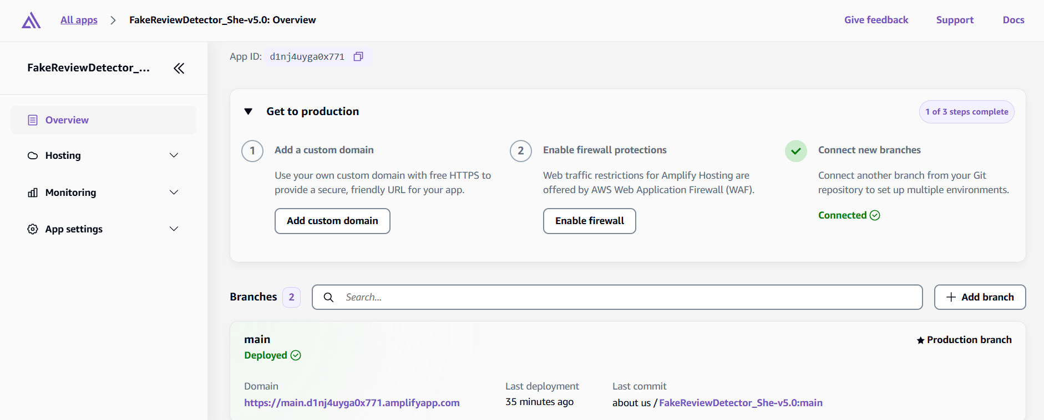
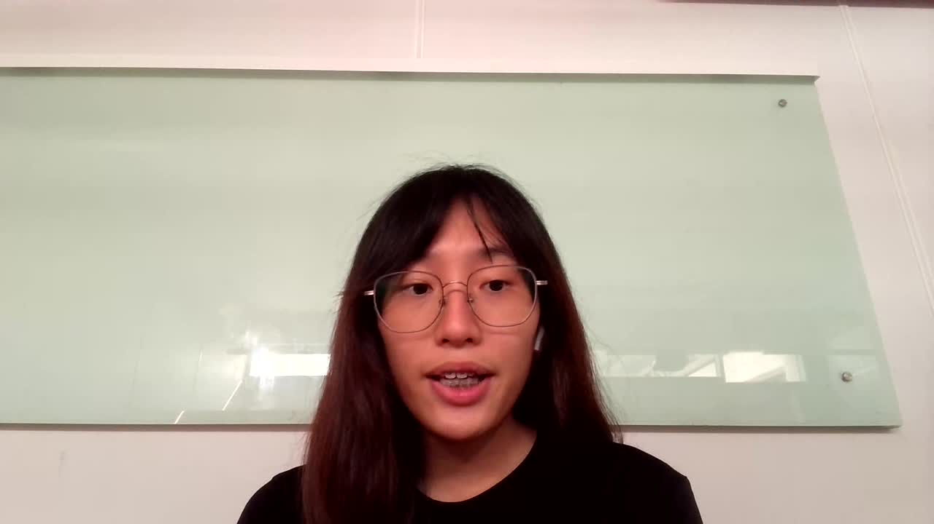
SHE++V5.0
HOME
PROBLEM
SOLUTION
OTHERS
“AWS SERVICES OVERVIEW FOR AI FOOD REVIEW DETECTOR”
1
AMPLIFY
Notes:
In our website, we used five main AWS services.
Amplify is responsible for hosting and deploying our React frontend

Slide 6
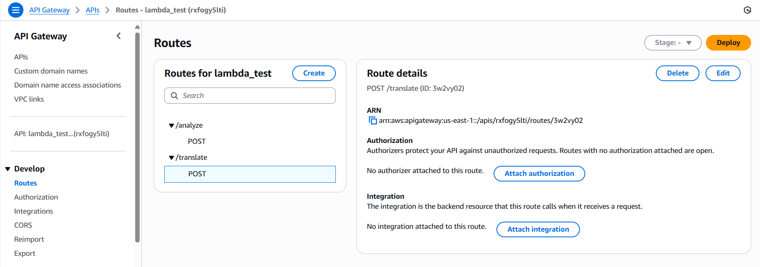

SHE++V5.0
HOME
PROBLEM
SOLUTION
OTHERS
“AWS SERVICES OVERVIEW FOR AI FOOD REVIEW DETECTOR”
2
API GATEWAY
Notes:
API Gateway acts as the bridge, providing REST endpoints to handle POST requests from the frontend

Slide 7
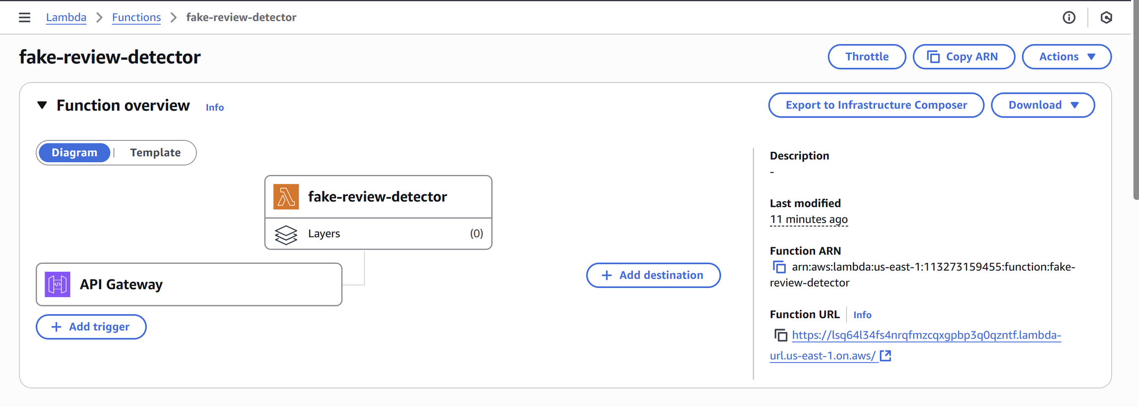

SHE++V5.0
HOME
PROBLEM
SOLUTION
OTHERS
“AWS SERVICES OVERVIEW FOR AI FOOD REVIEW DETECTOR”
3
LAMBDA
Notes:
Lambda serves as the core engine, running the backend logic and linking with other services.

Slide 8
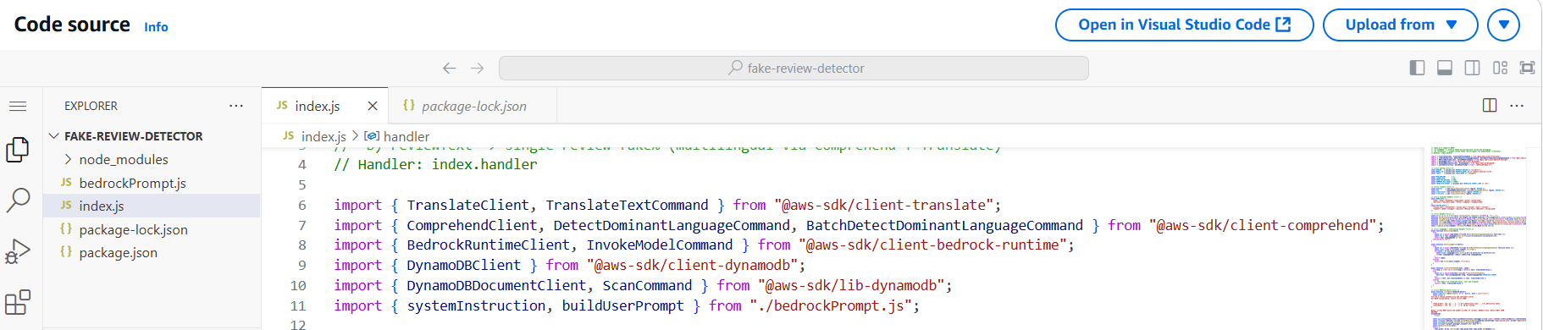

SHE++V5.0
HOME
PROBLEM
SOLUTION
OTHERS
“AWS SERVICES OVERVIEW FOR AI FOOD REVIEW DETECTOR”
4
BEDROCK
Notes:
Bedrock provides the AI capability to analyze reviews and detect fake ones.

Slide 9
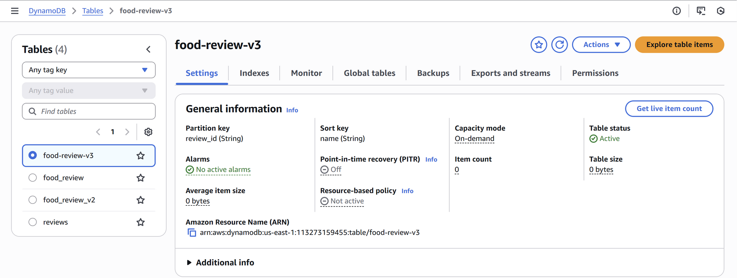

SHE++V5.0
HOME
PROBLEM
SOLUTION
OTHERS
“AWS SERVICES OVERVIEW FOR AI FOOD REVIEW DETECTOR”
5
DYNAMODB STORE REVIEWS DATA
Notes:
Finally, DynamoDB functions as the database, storing both the review data and the analysis results.
Working together, these services allow our website to operate smoothly, efficiently, and at scale.

Slide 10


SHE++V5.0
HOME
PROBLEM
SYSTEM
OTHERS
Business Impact :
Future Improvement:
Enhanced Trust and Transparency
Better Customer Experience
HELPS RESTAURANTS MAINTAIN CREDIBILITY BY DETECTING SUSPICIOUS CONTENT EARLY
REDUCES THE RISK OF MISLEADING REVIEWS AFFECTING CUSTOMER CHOICES
Improved Decision-Making for Business
Competitive Advantages
ENABLES PROACTIVE REPUTATION MANAGEMENT AND IMFORMED MARKETING AND STRATEGIES
EMPOWERS RESTAURANTS WITH INSIGHTS ABOUT COMPETITORS AND OVERALL INDUSTRY REVIEW TRENDS
Suggested highly rated restaurants
Add analysis and visualization functions
Notes:
The business impact of our project is significant.
First, it enhances trust and transparency by helping restaurants maintain credibility through detecting suspicious content early.
Next, it improves the customer experience by reducing the risk of misleading reviews that could affect customer choices.
It also supports better decision-making, enabling proactive reputation management and more informed marketing strategies.
Finally, it creates competitive advantages by empowering restaurants with insights into their competitors and overall industry review trends.
For future improvements, our project can suggest highly rated restaurants, giving customers more choices.
We also plan to add analysis and visualization functions to provide deeper insights and clearer understanding of review data.

Slide 11

THYNK UNLIMITED.
HOME
PROBLEM
SOLUTION
OTHERS
THANK YOU
-

